Slide 1

Improving DAGs with advanced concepts
Notes:
https://courses.cs.washington.edu/courses/cse403/13au/lectures/git.ppt.pdf
http://enos.itcollege.ee/~jpoial/allalaadimised/git/getting-started-with-git.pdf

Slide 2
Improving DAGs with advanced concepts
Minimising Repetitive Patterns With SubDAGs
Grouping tasks with SubDAGs and Deadlocks
Making different paths in DAGs with Branching
Make First Conditional Task Using Branching
Trigger rules for tasks
Changing how tasks are triggered
Avoid hard coding values with Variables, Macros and Templates
Templating tasks

Slide 3
Improving DAGs with advanced concepts
How to share data between tasks with XCOMs?
Sharing (big?) data with XCOMs
Trigger DagRunOperator or when DAG controls another DAG
Trigger a DAG from another DAG
Dependencies between DAGs with the ExternalTaskSensor
Make DAGs dependent with the ExternalTaskSensor

Slide 4
An Overview
SubDags: pros and troubles
Exchanging data with XComs
Different paths with Branching
Dynamic DAGs with Templates, Macros and Variables
Customizing the trigger rules of your tasks
And more ….

Slide 5
Minimising Repetitive Patterns With SubDAGs
How to make your dags cleaner

Slide 6
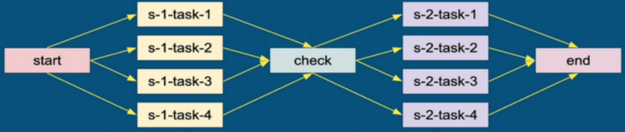
USE Case

Slide 7
Use Case
With SubDags:
Tasks are grouped into the two boxes with bold borders.

Slide 8
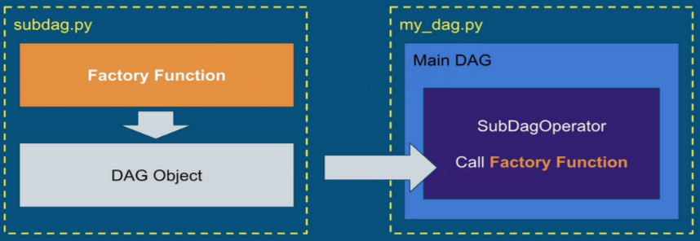
How to create SubDAG?

Slide 9
Important Notes
The main DAG manages all the subDAGs as normal tasks.
Airflow UI only shows the main DAG.
SubDags must be scheduled the same as their parent DAG.
Use SubDags with caution

Slide 10
Making different paths in your DAGs with Branching
Choose the right path

Slide 11
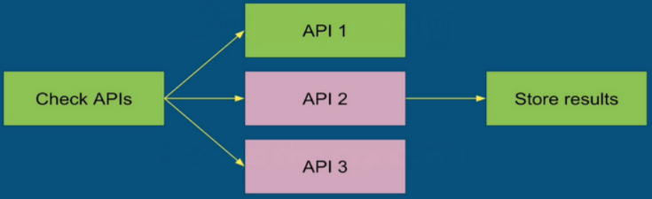
Use Case
LET'S start from a use case...

Slide 12
Definition
Branching is the mechanism allowing your DAG to choose between different paths according to the result of a specific task = BranchPythonOperator.

Slide 13
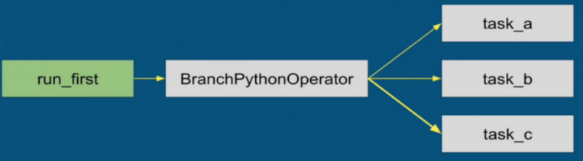
How Does It Work?

Slide 14
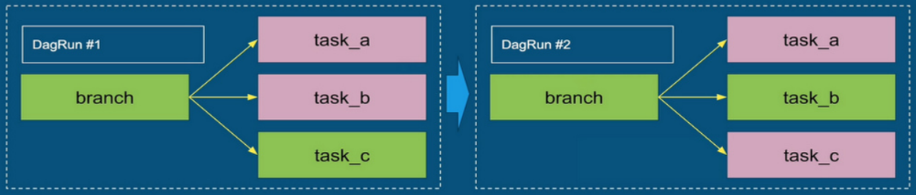
Depends_on_past and Branching
You can use depends_on_past with branching in your tasks

Slide 15
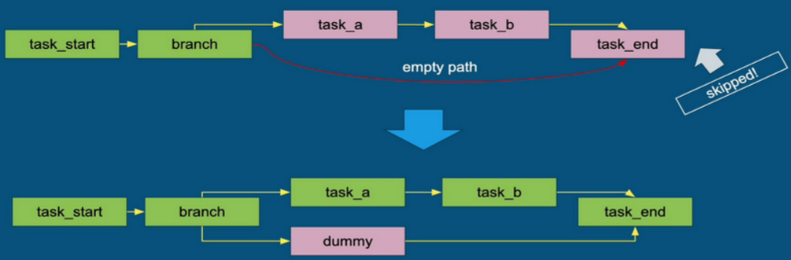
Important Notes

Slide 16
Thanks

